Slide 1
INFO6003 Lab-09
Gihan Shamike Liyanage
1142109

Slide 2
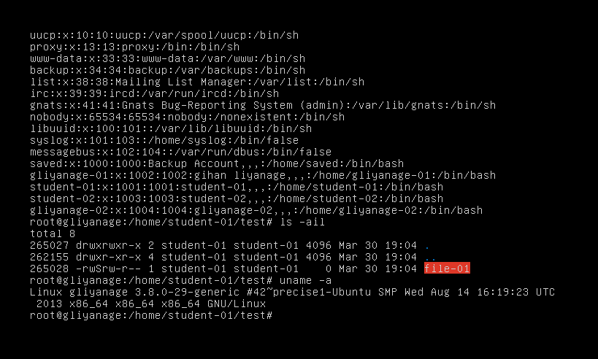
Slide #1
Why is this a capital S instead of a small s?
With “chmod 4664 file-01” command we assigned SUID privileges to file-01. Capital "S" is used in Ubuntu file permissions to indicate that the "setuid" or "setgid" bit is set, but the execute bit is not set for the owner or group.

Slide 3
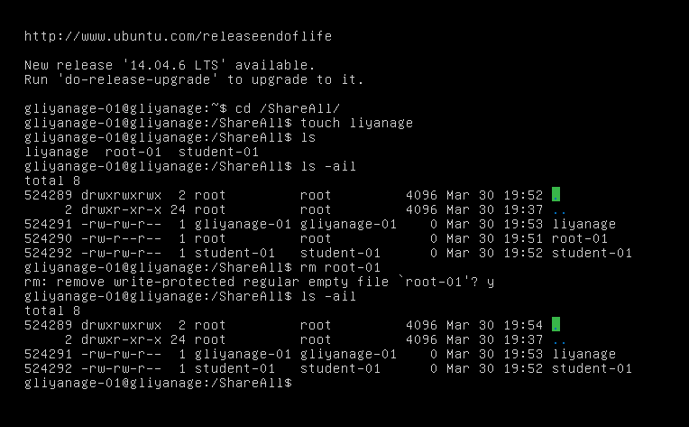
Slide #2

Slide 4
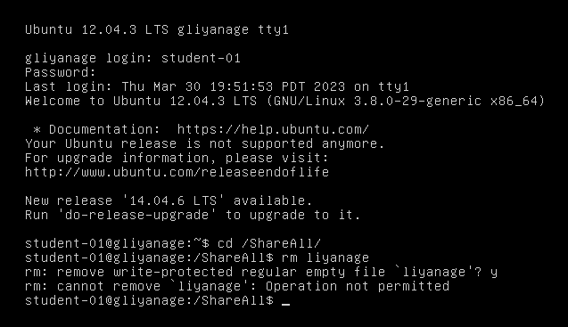
View the permissions on the directory. The t has now been added to denote the sticky bit. Also note the permissions on the tmp directory. Why does that make sense?
When you run the command "chmod 1777 /ShareAll", we are setting the permissions of the "/ShareAll" directory to 1777. The number 1 in the leftmost position indicates that the sticky bit is set.
When the sticky bit is set on a directory, only the owner of a file or directory within that directory (or the root user) can delete or rename that file or directory.
As for the permissions on the "tmp" directory, it's likely that the sticky bit is also set on that directory. The "/tmp" directory is a commonly used location for temporary files in Ubuntu, so it's often set with the sticky bit to prevent accidental deletion of important files by users who don't own them.
Log back in as student-01 and try to remove the yourlastname file located in /ShareAll.
What happened?
Was permission granted?
Operation was not permitted.

Slide 5
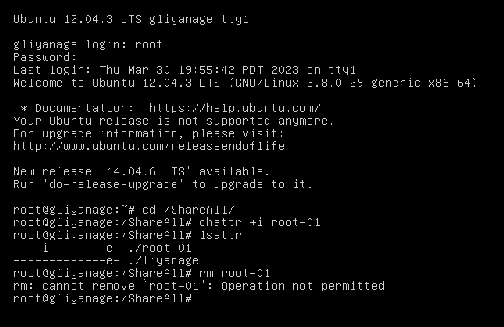
root@FOLusername:/ShareAll# chattr +i root-01
Use the lsattr command to view the attributes assigned to the file.
As root, try to remove the root-01 file.
What happened?
Was permission granted?
Operation was not permitted.

Slide 6
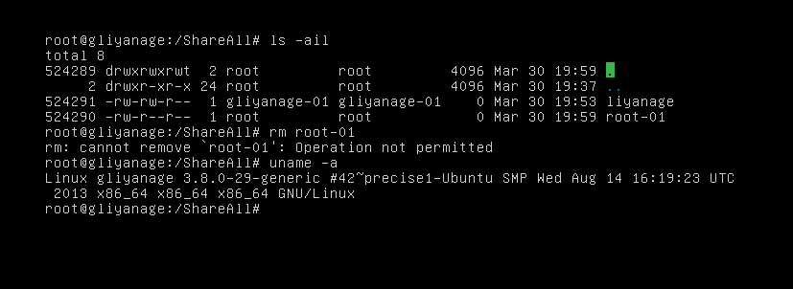
Slide #3

Slide 7
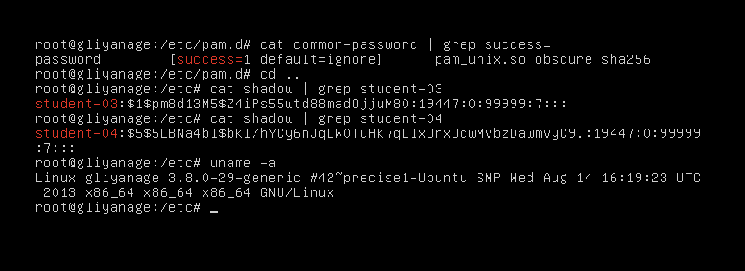
Slide #4

